Slide 1
Google Assistant-controlled
IoT-based Door Security Alarm
Aditya Kumar Gupta - 20BPS1030
Ankit Kumar Jha - 20BPS1050
Mugdha Kondhare - 20BPS1095

Slide 2
Abstract
The project intends to apply the Human Computer Interaction concept to IoT. We're planning to build a door security alarm system here. This door security alarm system is controlled by Google Assistant. When we say, "To, unlock the door," it is unlocked and a led glows to show it, and when we say, "To, lock the door," it is locked. If anyone tries to open the door now, the buzzer will sound and the owner will receive an email indicating that the security has been breached.

Slide 3
Problem Statement
According to the FBI, home burglary occurs for every 13 seconds and 3 out of 4 homes in US will be broken into within the next 20 years says a 2017 Home burglary statistics report. In the world that is advancing rapidly with technology where cars could drive on their own and drones could capture your food, burglary should not be of much concern but the above statistics just proves it wrong. What is the point of all the buzz words like IoT, AI, Machine learning etc if I simply can’t feel safe being at home?

Slide 4
Proposed Solution
So, in this project we will build our own security system which can detect if a door/window is opened. The alarm can be activated or de-activated through voice commands via Google assistant and when an intrusion is detected it will also send a mail to the owner and the relatives warning them about it. Cool thing is that entire thing runs on cloud so it can be controlled from anywhere in the world. Intriguing right!
Links –
(1) https://www.boltiot.com/blog
(2)https://circuitdigest.com/microcontroller-projects/iot-based-door-security-alarm-controlled-by-google-assistant

Slide 5
Project Status
Coding

Slide 6
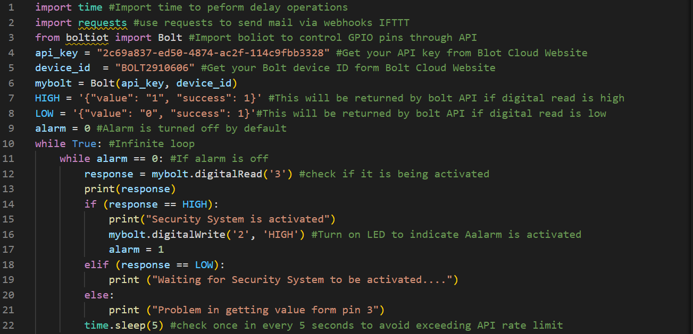

Slide 7
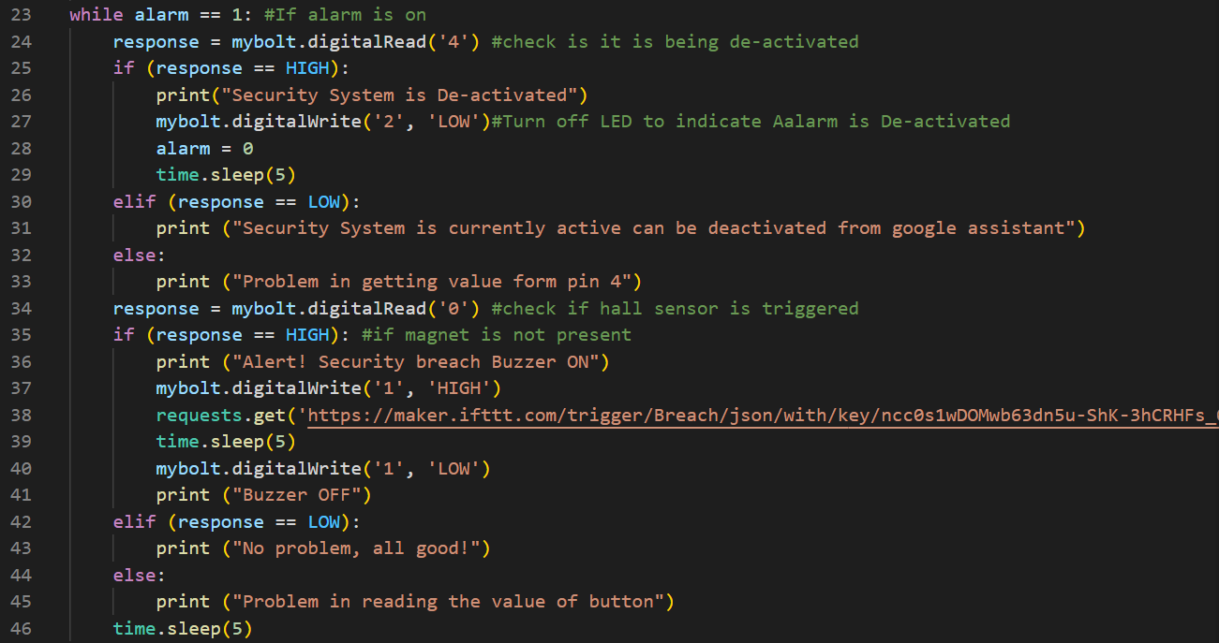

Slide 8
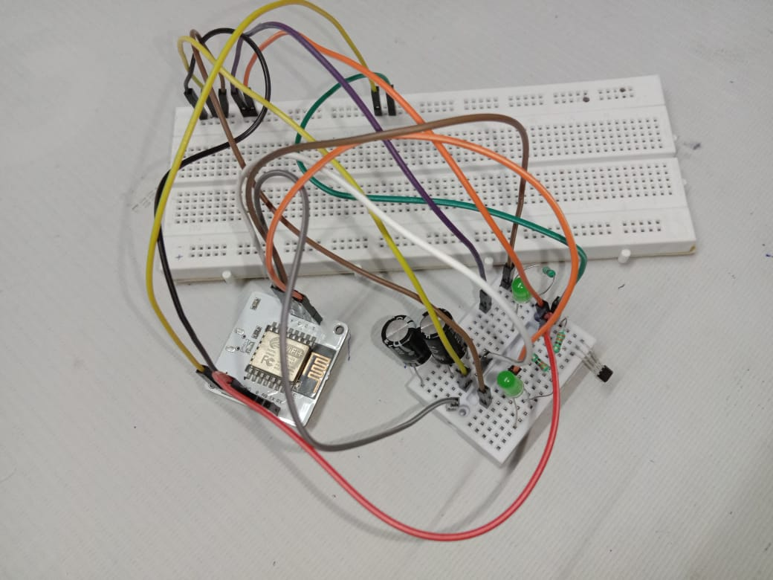
Hardware / Software

Slide 9
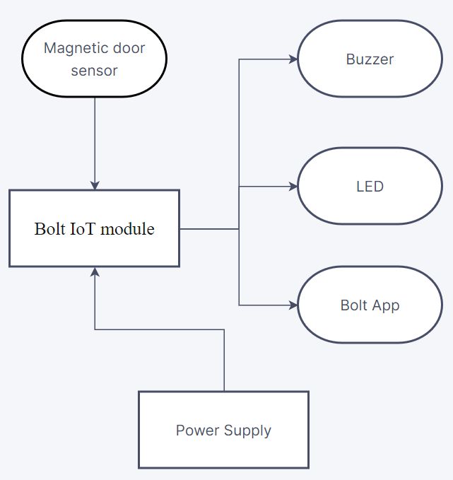
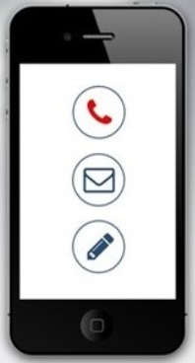
Working Model

Slide 10
Demo

Slide 11
Contributions :

Slide 12
Aditya:-
1)IFTTT applet configuration with Google Assistant V2 , webhooks services.
2) Created the custom service routines, so that they get activated on the voice command action.
3) Integrated with hardware, and helped to deploy it with software.

Slide 13
Ankit:-
1)IFTTT applet configuration with Gmail services.
2) Configured with requests package in python, to trigger the required services.
3) Did coding in python, to detect when the intrusion is detected.

Slide 14
Mugdha:-
1) Enabled Google assistant with Google Home to work with voice commands.
2) Did hardware connection.
3) Bolt iot cloud configuration with the hotspot to air the data and did python coding to activate the office security system.

Slide 15
Remaining Work :
Aditya - Webcam integration
Ankit - Fingerprint integration
Mugdha - Sending captured picture via email and security message to the user.

Slide 16
Partial - Working Model / Demo

